Slide 1



Analysis of Olympic Performance for Countries based on Government Type and Change in Government Throughout the Years
Sushanth Sreenivasa Babu
Sushma Mahadevaswamy
Snehal Lokesh
IS 597 Programming Analytics and Data Processing
SCHOOL OF INFORMATION SCIENCES

Slide 2
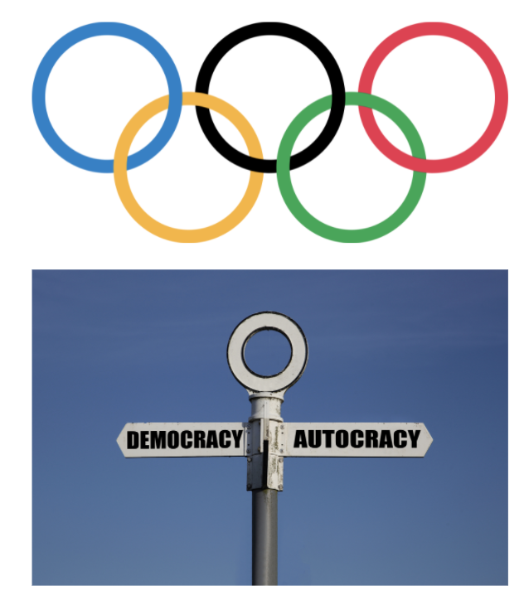
Objective
The Olympics is a global sporting event with more than 200 participants. These games are held every 4 years where countries showcase their athletic might.
The 20th Century saw the many countries change their government type and we also witnessed divisions and emergence of newer countries. With these instances in mind, we try to see if there has been a change in the Olympic performance of countries that had a change in their government type.
IS 597 Programming Analytics and Data Processing
SCHOOL OF INFORMATION SCIENCES

Slide 3





Success in the Olympics
Participants
Medals to Participants
Medals Won
Male to Female Representation
Average Age
IS 597 Programming Analytics and Data Processing
SCHOOL OF INFORMATION SCIENCES

Slide 4




Approach
Analyze the Data
Long Term Effects
01
02
03
04
Short-term Changes
Effect on the Future Events
IS 597 Programming Analytics and Data Processing
SCHOOL OF INFORMATION SCIENCES

Slide 5

Current Analysis
IS 597 Programming Analytics and Data Processing
SCHOOL OF INFORMATION SCIENCES

Slide 6
Future Scope
IS 597 Programming Analytics and Data Processing
SCHOOL OF INFORMATION SCIENCES
Notes:
Use Governace Indicators Dataset, Economic factors
Handle corner cases in joins
CI
War Analysis
Automate to look at plots of countries with short term changes and total change in polity
Western countries participation in Winter Olympics is higher
Sport wise performance

